Slide 1

Event sourcing: a primer
David Guida
Senior Software Engineer @ Microsoft www.davidguida.net

Slide 2
What is Event Sourcing?
“there are times when we don't just want to see where we are, we also want to know how we got there.”
-Martin Fowler
Notes:
So, let’s start by defining what Event Sourcing is. I really like this definition by Martin Fowler. Hands up who knows who I'm talking about
I think it encompassess the very soul of this pattern.
Because this is exactly what Event Sourcing is about: keeping track of everything that happened through the voyage.

Slide 3
What is wrong with the “standard” approach?
read data from the store​
make some modifications to it​
persist the current state of the data with the new values
Notes:
In a traditional create, read, update, and delete (CRUD) application, a typical data process is:
read data from the store
make some modifications to it
persist the current state of the data with the new values.
Now, usually the same store is used for reads and writes, and this might lead to poor performance. I said "might" because as with many things in our industry, it, well, depends.
But suppose that we obsessively want to optimize our system and favor reads over writes. Moreover, we all hope to have more than 1 user using our system. And with multiple concurrent users come great responsibilities... along with update conflicts.
And, without an extra effort to store additional auditing, history of the changes is completely lost.

Slide 4
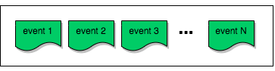
What is Event sourcing?
Notes:
Instead of storing just the current state of the data in a domain, we can use an append-only store to record the full series of actions taken on that data.
Every change to the state of an application is captured in an event object.
These event objects are then stored in the same order they were applied.
After we have persisted these "Domain" events, we can also tell the world that something has changed. And we do it by publishing "Integration" Events.
At this point we can have all sorts of subscribers reacting to these Integration Events and performing other tasks.
Typical usea of these Integration Events could be:
generation of materialized views (application UI, reporting)
integration with external systems

Slide 5
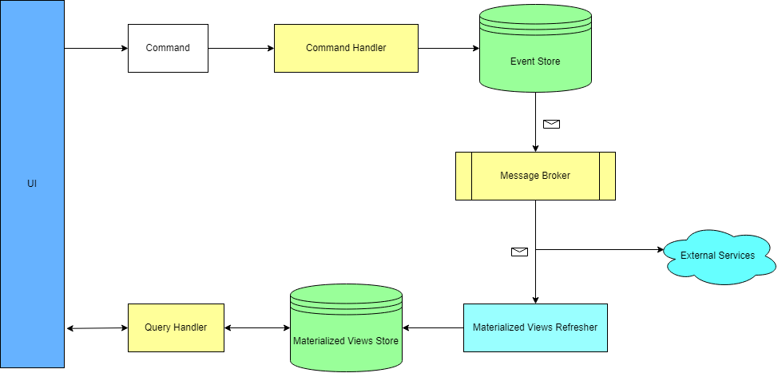
EVENT SOURCING FLOW
Notes:
Event Sourcing is used in conjunction with another pattern, CQRS (command query responsibility Segregation). With it, we're slicing our application logic vertically. In addition to that, we're segregating state mutation (command handling) from the data retrieval (query handling).
Materialized views are also often called “projections”

Slide 6
Entity Rehydration
In order to operate, Command Handlers have to “rehydrate” an entity from its events stream.
Notes:
This means that we have to read the entire stream and apply events one after another. This process is called "Rehydration".
Now, as I said, we need to replay the entire stream for a specific Aggregate. This might be ok at the very beginning, but after some time we might run into some trouble.
For example, suppose we use Event Sourcing to handle bank transactions.
If a user does 3 transactions per day, this means 1095 events per year.
It’s easy to see that this doesn’t scale well

Slide 7
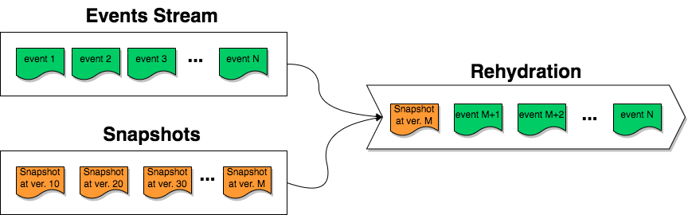
REHYDRATION WITH SNAPSHOTS
Notes:
A simple solution is to take “snapshots” of an entity every N events
Each snapshot represents an entity at a certain moment in time (eg. event version)

Slide 8
Typical use cases
Finance
Healthcare
Government
Retail, e-commerce
Transport (shipping, logistics)
Notes:
Event Sourcing is extremely useful every time it’s necessary to maintain a history of everything happened on our entities.
the most common requirement is the need to provide an immutable audit logs to ensure compliance

Slide 9
The goodies: Fail-safety
If the query-side fails, its data can be reconstituted from the event store.
Notes:
Let's start with the easy wins: fail-safety on the Query Side.
We can't have Event Sourcing without CQRS. Which means that our Query-models are a "projection" of our Aggregates. And this means that if our Query DB fails, the datacenter goes on fire or whatever, we can always rebuild the Views.

Slide 10
The goodies: Flexibility
Any type of Event can be stored.
Notes:
Event Sourcing forces you to model events as first class objects, rather than through implicit state changes (ie. changing a value in a table).
We basically steer away from Anemic Models and "Persistence-First" to "Persistence Agnosticism".
Your models will closely resemble the actual business processes you're modelling.
This brings a lot of clarity to the table and stops you from getting lost in the details of your storage technology.
It makes the implicit explicit.
Moreover, changing DB technology is now even easier, for both Writes and Reads

Slide 11
The goodies: Performance
(Maybe.)
Notes:
You don't need to use a fancy database to store your events, any standard Relational DB will do just fine.
Databases are optimised for append only operations, which means that adding new data is fast, while modifying data is slow.
With Event Sourcing our write operations are always append-only, so it's highly unlikely that we will incurr into any kind of deadlock or performance bottleneck.
That being said, there are several checks we have to perform before storing an aggregate, especially when it comes to guarantee its consistency. And these don't come cheap.

Slide 12
The goodies: multiple Read Models
Desktop
Mobile
Reporting
Etc...
Notes:
One of the main benefits of Event Sourcing is that we can have as many Read Models that we want, and even have them geolocated where we want.
We could even use different persistent mechanisms.
We can have read models specific for a desktop app, for a mobile app, for reporting. We could store them in SQL, in MongoDB, as files.

Slide 13
Things to consider: eventual consistency
Projections are not refreshed immediately after an event is published.
Notes:
This eventual consistency might not necessarily be an issue. It depends on the application Domain and how much delay we can afford for the data to be available.
Of course we can definitely use a distributed transaction and update our Read Models when we process the Command and store the Events. Yes, that works and we would immediately have the data available for querying.
However, we would have to:
deal with distributed transactions (good luck with that)
lose the ability to comfortably add more than one Read model
So, one potential strategy to make our UI users happy, is to build a “temporary” projection on the client, while the backend is processing the update.
In any case, when dealing with Eventual Consistency we need to remember that every service consuming the projections (eg. the UI) has to be aware of this potential delay and plan accordingly.

Slide 14
Things to consider: data errors
Events are immutable.
Notes:
Let's take a step back and talk about philosophy. What is an event? Is something that happened in the past.
Once stored, events are to be considered immutable, and by such they cannot be changed.
If there are errors in the persisted data we can correct them only by appending more events.
This can be very problematic in case your application is handling sensitive data subjected to laws and regulations, because of course purging data becomes complicated.
Moreover, events are usually stored as serialized blobs, using JSON or another format. While this can be very flexible, on the other hand makes support and incident management much harder than with a regular, old-fashion relational storage.
Imagine asking a client support rep to investigate the data in an Events table. How easy would that be compared to a standard CRUD applcation?

Slide 15
Things to consider: schema changes
Updating an event schema definitely won’t change the data persisted so far.
Notes:
This is extremely common, especially when we realize we have missed some fields in an event.
So, unless we take on the risk and complexity of updating every event ever stored, the other option is to handle different schemas in code, which of course adds another level of complexity.

Slide 16
Things to consider: event modeling
Events should be modeled based on the use cases of the business domain.
Notes:
The events should have a deep meaning and importance to our business. Everything that happens around us can be described as events, but that does not mean that we need to implement everything that happens in our software.
For example we should avoid things like ‘ButtonClicked’ or "StuffHappened". We don't need everything, just the events that have real value for our context.
Moreover, events like “ShippingUpdated" should be avoided as they are adding no real meaning nor value. This is especially true when we have to inspect our database.
Our source of truth is not the Query-side (for example the Reports db). Our source of truth is the Events Store.
So, instead of ShippingUpdated, we should use ‘OrderShipped’ or ‘OrderArrived’

Slide 17
Things to consider: onboarding
Onboarding a new team member, takes usually more time than a regular CRUD application.
Notes:
Event Sourcing is a complex pattern.
it’s also a big philosophical switch, from the good ol’ CRUD to this shiny new way.
Adding a new team member on an already existing project has its own challenges.
But try convincing a whole team for a brand new system. There will be the ones who would be enthusiastic and immediately jump on the wagon and others who will be completely against it.
So be prepared to some push back.

Slide 18
Demo time!
Notes:
A simple solution is to take “snapshots” of an entity every N events
Each snapshot represents an entity at a certain moment in time (eg. event version)

